Slide 1
Pregnancy risk factors and birth outcomes within Oregon and Idaho’s
American Indian/Alaska Native population (2008-2010)
Suzanne Zane
Maternal and Child Health Epidemiologist
and the
Improving Data & Enhancing Access (IDEA-NW) Project
Quarterly Board Meeting
January, 2013
Pendleton, OR

Slide 2
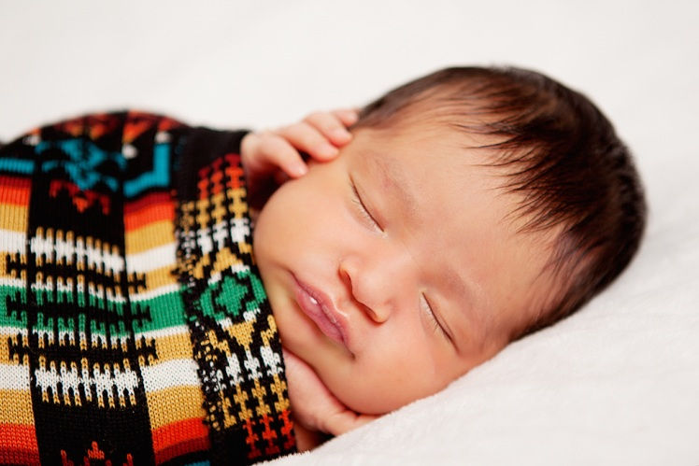

Background
American Indians/Alaska Natives (AI/AN) at higher risk for many health conditions and indicators, including obesity, diabetes, preterm birth, smoking, domestic violence, injury
Infant mortality rates for AI/AN in Pacific Northwest lower than for AI/AN people in rest of U.S.; however, the rate is still twice that for white infants
Limited MCH data available to tribes and Indian health programs; race-specific data rarely published due to small numbers

Slide 3
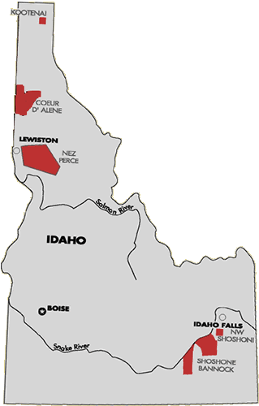
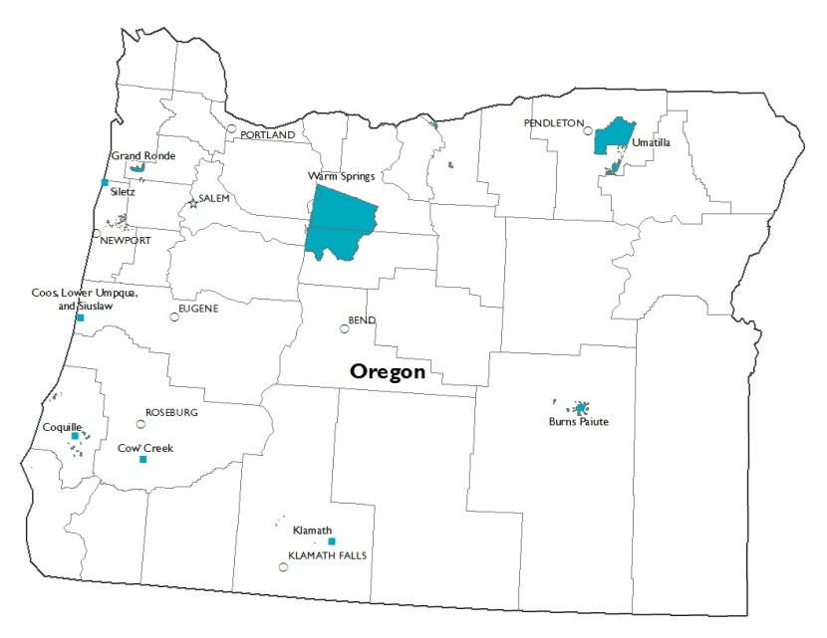
Oregon and Idaho AI/AN population
14 federally-recognized Tribes
Census estimate: 145,608
  Includes 35,370 women ages 15-44
12 of 14 tribes have clinics, plus Chemawa IHS clinic
Limited prenatal & OB services
Some tribal WIC programs
Chemawa IHS clinic

Slide 4
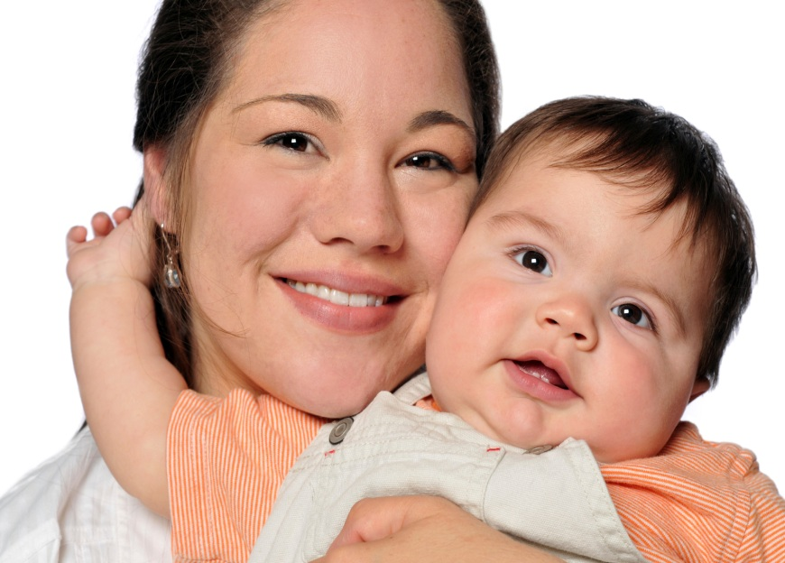
Race coding on birth certificates
This is the first linkage between Northwest Tribal Registry and state birth certificates
AI/AN births: those with…
  Match of mother to the Tribal Registry, and/or
  Any mention of AI/AN race for mother, and/or
  Any mention of AI/AN race for father

Slide 5

Demographics
Total AI/AN births (after linkage): 9,403
Mean maternal age = 25.1
54.1% unmarried
22% less than 12th grade education
60.2% WIC use
1.2% pre-pregnancy diabetes

Slide 6
Demographics

Slide 7
Maternal risk factors

Slide 8
Maternal risk factors

Slide 9
Pregnancy care

Slide 10
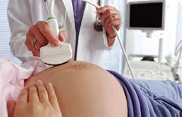
Pregnancy care
Tested for HIV (Oregon)
  AI/AN: 83.0%
  NHW: 80.7%

Slide 11
Pregnancy care
Oregon AI/AN: 31.4% decrease
Idaho AI/AN: 21.9% decrease
Oregon NHW: 29.8% decrease
Idaho NHW: 21.7% decrease

Slide 12
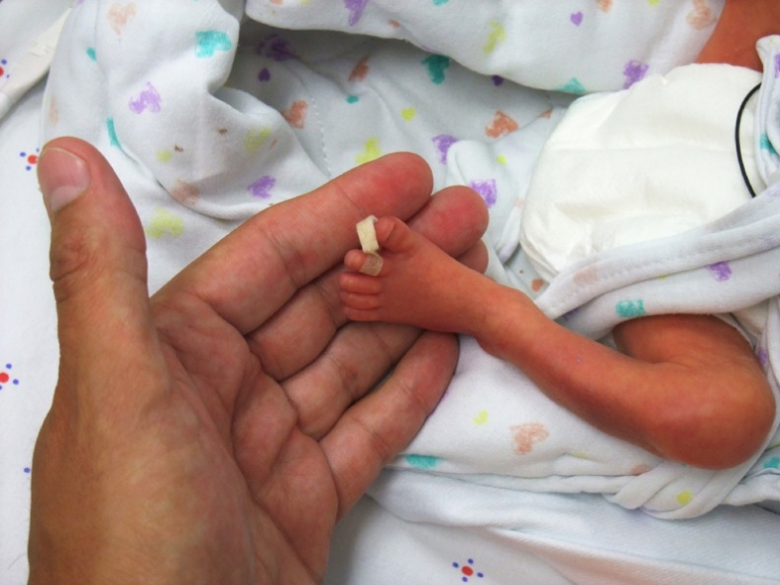
Birth outcomes
 |  |  | AI/AN | NHW
Gestational age
 | Early preterm (<34 wks) |  | 2.6% | 1.9%
 | Preterm (34 to <37 wks) |  | 7.2% | 6.1%
 | Term (>=37 wks) |  | 90.2% | 91.9%
Method of delivery
 | Vaginal |  | 70.1% | 73.0%
 | Cesarean |  | 29.9% | 27.0%
Birth weight
 | Very low (<1500 g) |  | 1.2% | 1.0%
 | Low (1500 - <2500 g) |  | 6.0% | 5.1%
 | Normal (2500 - <4000g) |  | 82.3% | 83.7%
 | High (>4000 g) |  | 10.5% | 10.3%
Notes:
ALL NUMBERS UPDATED

Slide 13
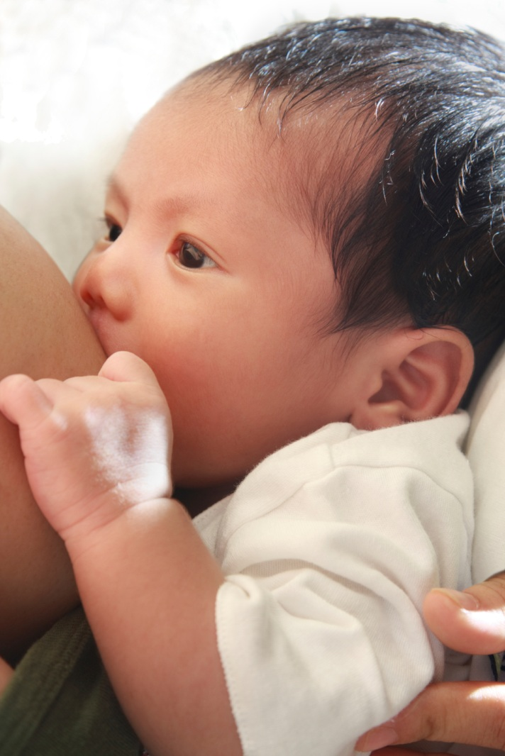
Birth outcomes
NICU admission (Oregon)
  AI/AN: 8.5%
  NHW: 6.9%
Breastfeeding started at hospital (>9% unknown/missing data)
  AI/AN: 79.1%
  NHW: 82.0%

Slide 14
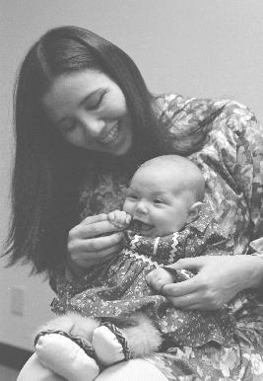
Highlights/ Conclusions
Birth/fertility rates 2-3 times higher
AI/ANs have elevated prevalence of pregnancy risk factors
but
Birth outcomes we looked at were not vastly different than NHW
AI/ANs doing somewhat better than NHW on HIV screening and smoking reduction
Use additional information sources to learn more, and share findings to assist program initiative decision-making

Slide 15
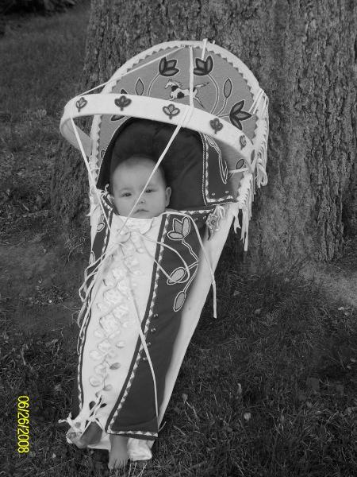
Next steps & Recommendations
  Future planned analyses
  MCH strategic plan
  Focus on young moms and teens
    Prenatal care
    Teen empowerment and prevention efforts

Slide 16
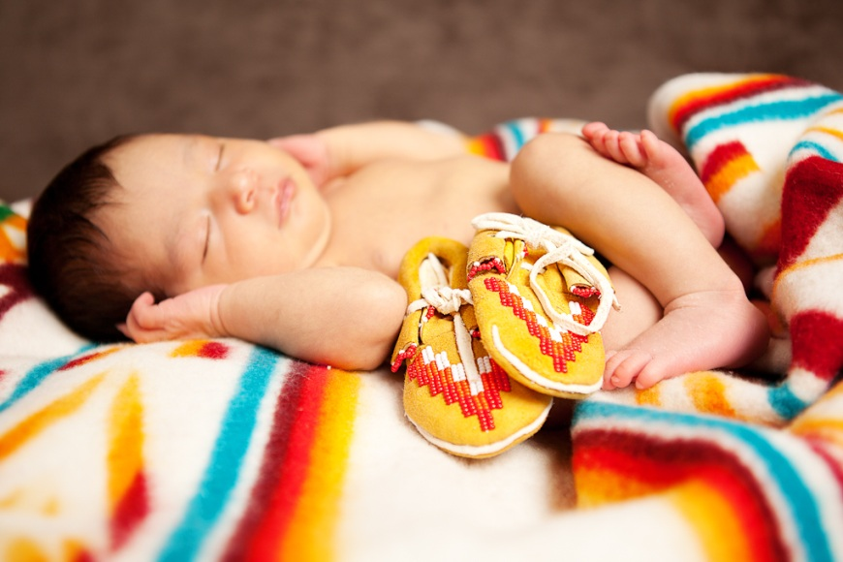
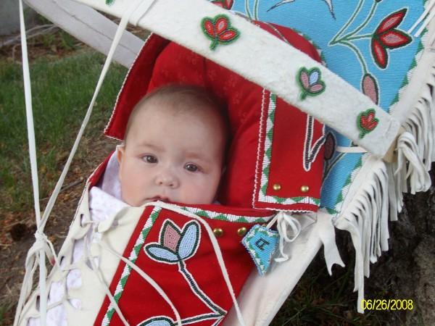
Limitations
Our selection of AI/AN birth records was not standard (including linked records and dads’ race info), so not comparable with other data
NW Tribal Registry doesn’t cover entire Oregon and Idaho’s entire AI/AN population

Slide 17
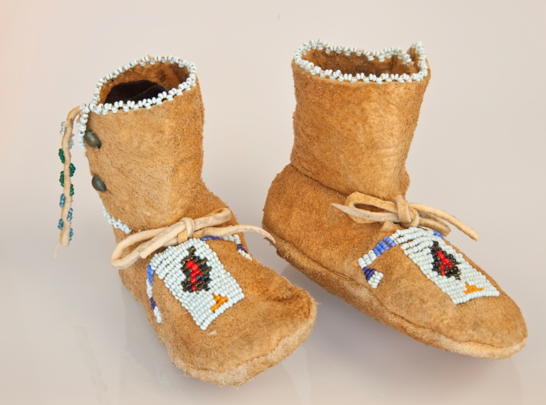
Acknowledgments
Coauthors
  Megan Hoopes, Jenine Dankovchik, Kristyn Bigback, Meena Patil, and Victoria Warren-Mears
Center for Health Statistics, Oregon Health Authority
Bureau of Vital Records and Health Statistics, Idaho Department of Health and Welfare
Board babies and moms

